Slide 1
Utilization of a Market-Based Approach for solving the Multi-Robot Task Allocation problem
Presented by:
Mahmoud Mostafa Elbarawy
Supervised by:
Prof. El Sayed I. Morgan
Dr. Omar M. Shehata
M. Sc Ali Bahaa

Slide 2
Outline
Motivation
Introduction
Problem Statement
State of Art
Thesis Contribution
Methodology
Results
Conclusion
List of publication
Future Recommendation
References

Slide 3
Motivation
Outline
Motivation
Introduction
Problem Statement
State of Art
Thesis Contribution
Methodology
Results
Conclusion
List of publication
Future Recommendation
References
Utilization of a Market-Based Approach for solving the Multi-Robot Task Allocation problem
Task Allocation
Multi-Robot
Market-Based Approach

Slide 4
Motivation
Outline
Motivation
Introduction
Problem Statement
State of Art
Thesis Contribution
Methodology
Results
Conclusion
List of publication
Future Recommendation
References
Foxmeyer’s 1996 Distribution Disaster
Foxmeyer was the second largest drug distributor in the U.S., with sales over $5 billion dollars in a highly competitive industry.
The problem was in handling the large scale management of warehouse .
The consequences of this action Huge sales losses; Foxmeyer eventually bought by its rival McKesson for only $80 million.

Slide 5

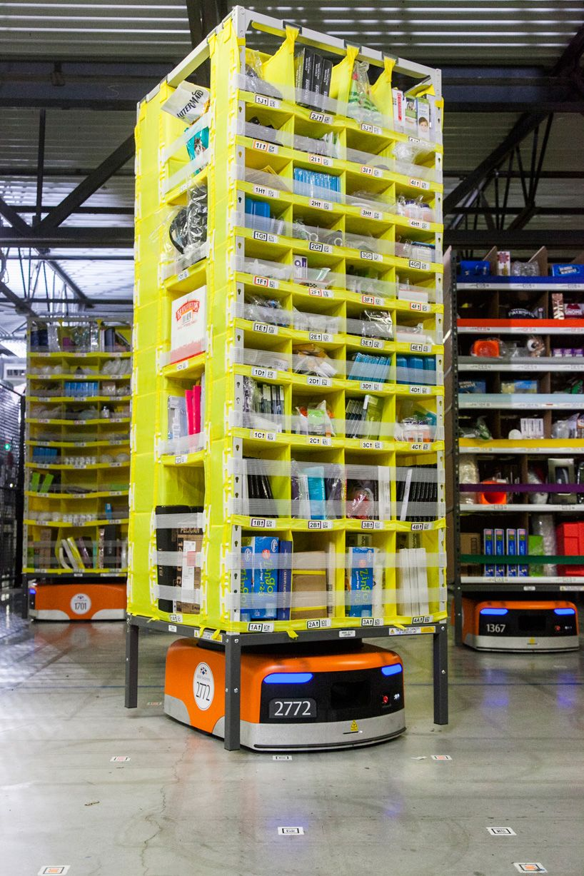
Motivation
Outline
Industrial revolution
Motivation
Introduction
Problem Statement
State of Art
Thesis Contribution
Methodology
Results
Conclusion
List of publication
Future Recommendation
References
Fig 1.
Fig 2.

Slide 6
Motivation
Outline
Industrial revolution
Motivation
Introduction
Problem Statement
State of Art
Thesis Contribution
Methodology
Results
Conclusion
List of publication
Future Recommendation
References
Increasing performance.
Increasing reliability.
Reduce human error.
Reduce time taken to complete a certain task.

Slide 7

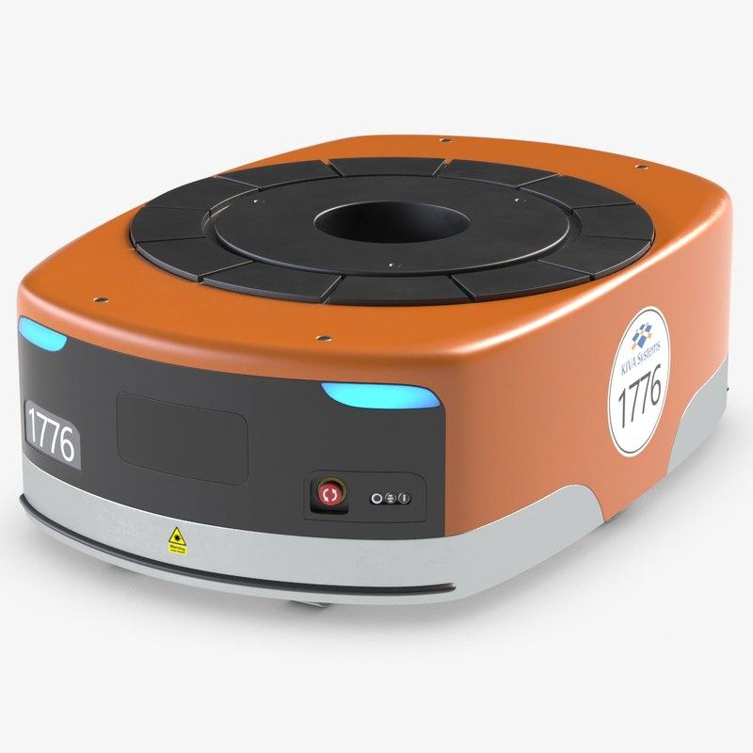
Motivation
Outline
Industrial revolution
Motivation
Introduction
Problem Statement
State of Art
Thesis Contribution
Methodology
Results
Conclusion
List of publication
Future Recommendation
References
Fig3 .
Fig 4.
Kiva Robot

Slide 8
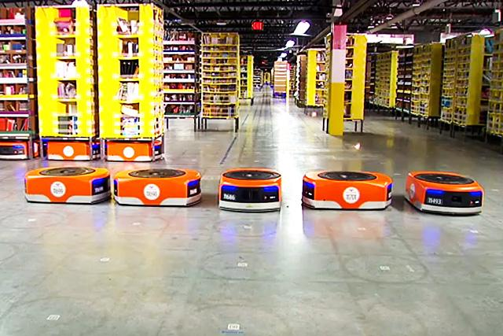
Introduction
Outline
What is Multi-Robot system MRS ?
Motivation
Introduction
Problem Statement
State of Art
Thesis Contribution
Methodology
Results
Conclusion
List of publication
Future Recommendation
References
Definition: Multi-robot systems (MRS) are a group of robots that are designed aiming to perform some behave.
Fig 5.

Slide 9
Introduction
Outline
Motivation
Introduction
Problem Statement
State of Art
Thesis Contribution
Methodology
Results
Conclusion
List of publication
Future Recommendation
References
MRS challenging problem
In order to apply (MRS) in real word applications there are a challenging problems like
Group formation,
Communication relaying
Cooperative object detection and tracking,
self-organization
Task allocation

Slide 10
Problem Statement
Outline
Motivation
Introduction
Problem Statement
State of Art
Thesis Contribution
Methodology
Results
Conclusion
List of publication
Future Recommendation
References
Multi-Robot Task Allocation problem MRTA
”Which Robot is responsible to handle which task such that the overall system performance of the team of Robots is optimized ?”
2^n-1 combination of solutions are available so needed to be solved in an optimized way since there is a lot of solutions .
There are two main approaches for solving such a problem:
Market-based approach
• optimization approach
This thesis focus in solving Task allocation problem using Market-based approaches

Slide 11
State of Art
Outline
Motivation
Introduction
Problem Statement
State of Art
Thesis Contribution
Methodology
Results
Conclusion
List of publication
Future Recommendation
References
Multi-Robot Task allocation (MRTA) problem
Modeling of the problem :According to [1] Multi-robot task allocation: A review of the state-of-the-art. In Cooperative Robots and Sensor Networks 2015
Discrete Fair Division
ALLIANCE Efficiency Problem (AEPs)
Optimal Assignment Problem (OAPs)
Multiple Traveling Salesman Problem(MTSPs)

Slide 12
State of Art
Market-based approach in solving MRTA problem
Outline
Name | Year | Description
Balancing task allocation in multi-robot systems using clustering and auction based mechanisms [7]. | 2011 | Clustering technique with an auction process . Objective minimize the distance. Two scenarios were considered: one with two clusters and the other with three clusters. The results showed the scenarios that were used are not sufficient to prove the effectiveness of the algorithm.
Move and improve: A distributed multi-robot coordination approach for multiple depots multiple travelling salesmen problem [8]. | 2014 | MTSP was solved through market-based approaches. The authors suggested a new approach called movement and improvement . The results showed the superiority of movement in comparison with centralized GA algorithm
Clustering market-based approach for multi-robot emergency response applications. [9]. | 2016 | The study showed that the CMMTSP balances contradictory goals and lowers implementation time.the use nearest neighbour to solve the Tour.
Motivation
Introduction
Problem Statement
State of Art
Thesis Contribution
Methodology
Results
Conclusion
List of publication
Future Recommendation
References

Slide 13
State of Art
Outline
Auctions
Motivation
Introduction
Problem Statement
State of Art
Thesis Contribution
Methodology
Results
Conclusion
List of publication
Future Recommendation
References
Generally, any protocol that allows agents to indicate their interest in one or more resources or tasks is considered an auction.
Submission Bidding stage
Selection Winner stage
Announcement stage
Contract stage
Bidding : is to calculate the Cost according to the Objective function .

Slide 14
State of Art
Outline
Auctions
Motivation
Introduction
Problem Statement
State of Art
Thesis Contribution
Methodology
Results
Conclusion
List of publication
Future Recommendation
References
Name | Year | Description
Coordination for multi-robot exploration and mapping[10]. | 2000 | a sequential auction. the auctioneer sells a sequence of items, one item at a time. computation time is large
Multi-robot systems: from swarms to intelligent automata[11]. | 2012 | Assigning positions in robot tennis Parallel Auctions all items are bid on simultaneously, such that the auction lasts one round.
Auctions for multi-robot task allocation in communication limited environments[12]. | 2019 | Combinatorial Auction was implemented a comparative study Done between different types of auctions and it proves that Combinatorial auction is the fastest type. They recommend to investigate diffrent typs of huerstic techniques in solving TSP.

Slide 15
Thesis Proposition
Motivation
Introduction
Problem Statement
State of Art
Thesis Contribution
Methodology
Results
Conclusion
List of publication
Future Recommendation
References
Efficient market Auction type for MRTA problem which is:
Cluster Combinatorial Auction (C.C.A).
2-opt heuristics solver for TSPs.
Iterative market (IT) solution.
A comparative study .

Slide 16
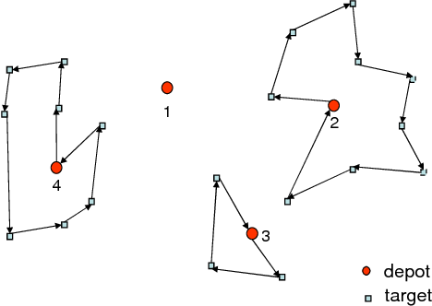
Methodology
Outline
Motivation
Introduction
Problem Statement
State of Art
Thesis Contribution
Methodology
Results
Conclusion
List of publication
Future Recommendation
References
Implemented model
We used a Multiple travel salesman as a model to solve the MRTA problem
Definition: is a generalization of the Traveling Salesman Problem (TSP).Given a set of cities, and m salesmen, the objective of it is to determine a tour for each salesman such that to minimize the total cost. The cost could be distance or time.
Fig6 .[6]

Slide 17
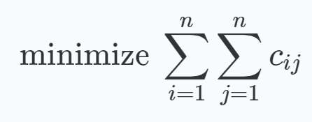
Methodology
Outline
Motivation
Introduction
Problem Statement
State of Art
Thesis Contribution
Methodology
Results
Conclusion
List of publication
Future Recommendation
References
Implemented model
Objective Function :
The mTSP can be formally defined on a graph G=(V,D) where V is the set of (T+R) nodes and D is the set of arcs. Let C=(Cij) be the distance matrix associated with D.
Where Cij=√(x2 - x1)^2 + (y2 - y1)^2. when there is no Obstacles in the map.
Is to minimize the distance traveled by each and every Robot.
Is to minimize the Maximum distance traveled by a Robot in the system.

Slide 18
Methodology
Outline
Motivation
Introduction
Problem Statement
State of Art
Thesis Contribution
Methodology
Results
Conclusion
List of publication
Future Recommendation
References
Distance matrix
 | T1 | T2 | T3 | T4 | R1 | R2
T1 | 0 | 20 | 45 | 30 | 10 | 7
T2 | 20 | 0 | 3 | 9 | 5 | 13
T3 | 45 | 3 | 0 | 7 | 17 | 25
T4 | 30 | 9 | 7 | 0 | 18 | 27
R1 | 10 | 5 | 17 | 18 | 0 | 24
R2 | 7 | 13 | 25 | 27 | 24 | 0
T=Tasks
R=Robots

Slide 19
Methodology
Outline
Motivation
Introduction
Problem Statement
State of Art
Thesis Contribution
Methodology
Results
Conclusion
List of publication
Future Recommendation
References
Problem parameters :
Agent (robot) :
Task :
1-ID.
2-Velocity.
3-energy level.
4-max weight to left.
5-position.
1-ID.
2-position.

Slide 20

Methodology
Outline
Motivation
Introduction
Problem Statement
State of Art
Thesis Contribution
Methodology
Results
Conclusion
List of publication
Future Recommendation
References
Combinatorial Auction
Bidding on a set (Group) of Tasks.
Take only one round.
Fastest type of Auction[12].
Fig 7.[15]

Slide 21
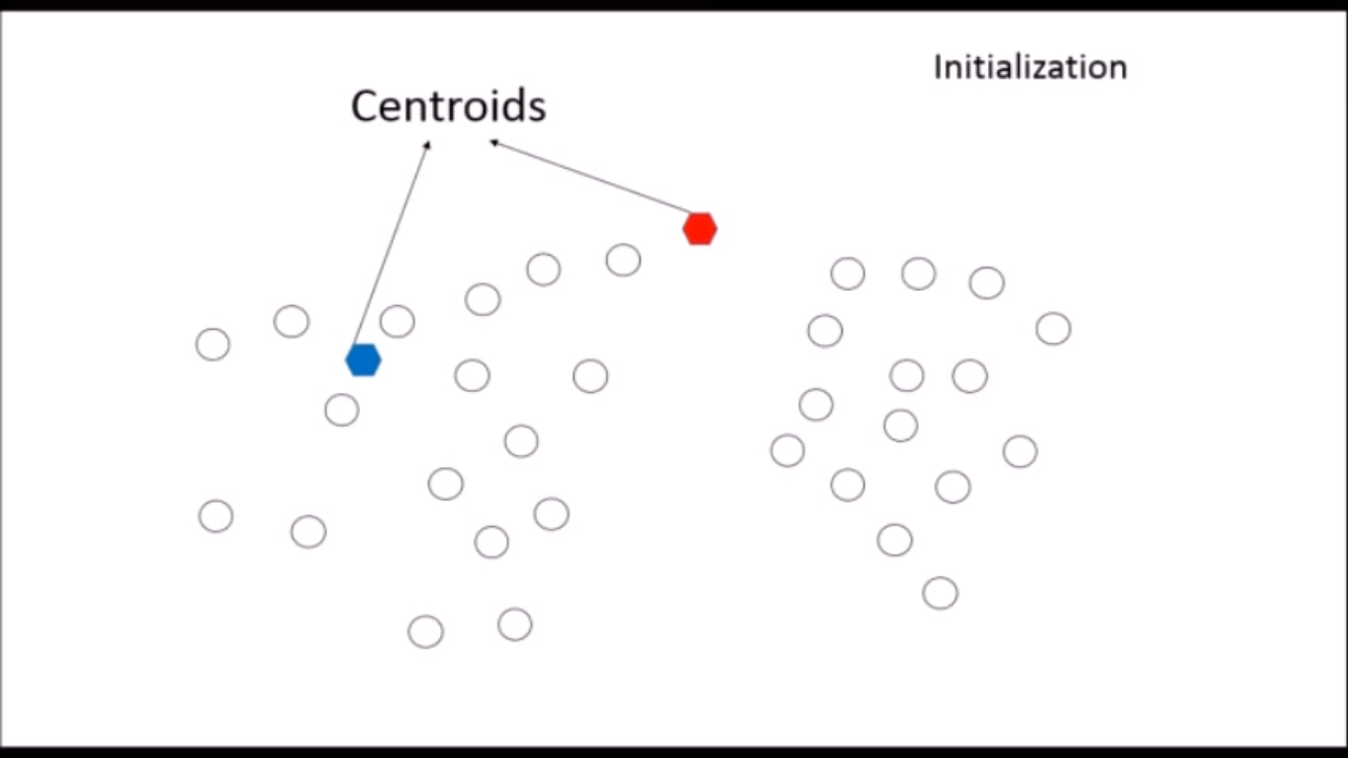
Methodology
Outline
Clustering Technique
Motivation
Introduction
Problem Statement
State of Art
Thesis Contribution
Methodology
Results
Conclusion
List of publication
Future Recommendation
References
K-means
K centroids are randomly location in the map
Fig8 .

Slide 22
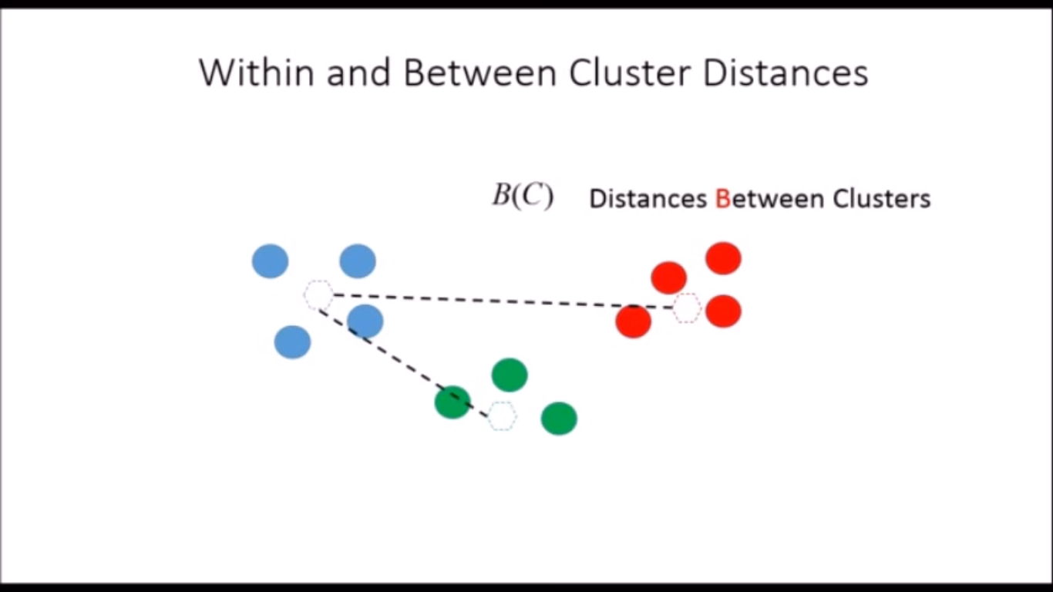
Methodology
Outline
Clustering Technique
Motivation
Introduction
Problem Statement
State of Art
Thesis Contribution
Methodology
Results
Conclusion
List of publication
Future Recommendation
References
Calculate the Distance
Fig9 .

Slide 23
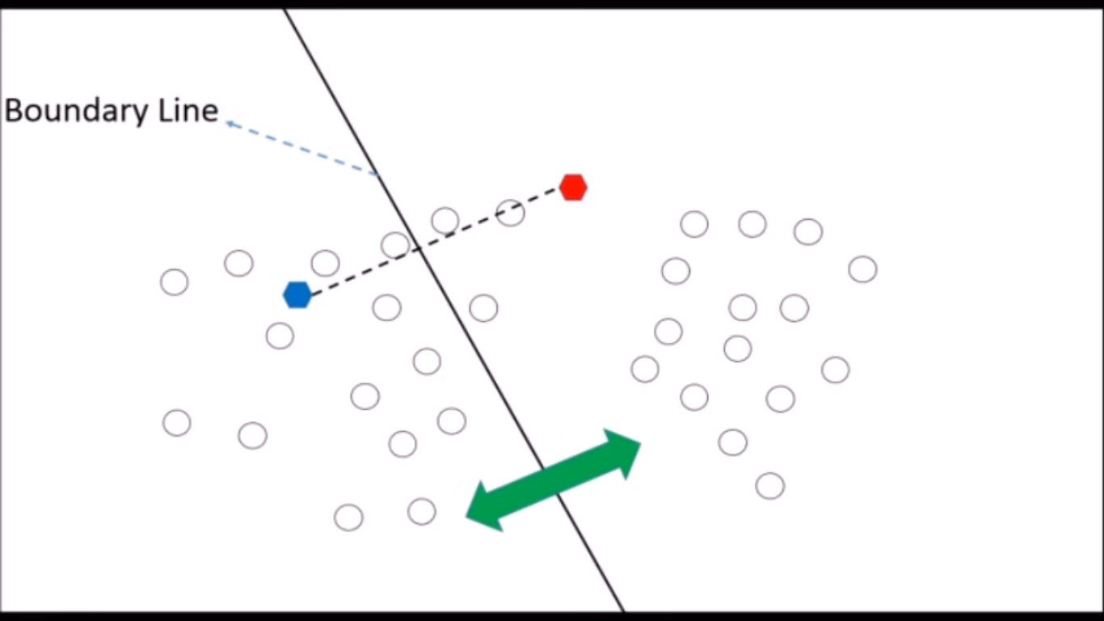
Methodology
Outline
Clustering Technique
Motivation
Introduction
Problem Statement
State of Art
Thesis Contribution
Methodology
Results
Conclusion
List of publication
Future Recommendation
References
Divide the map in to clusters
Fig10 .

Slide 24
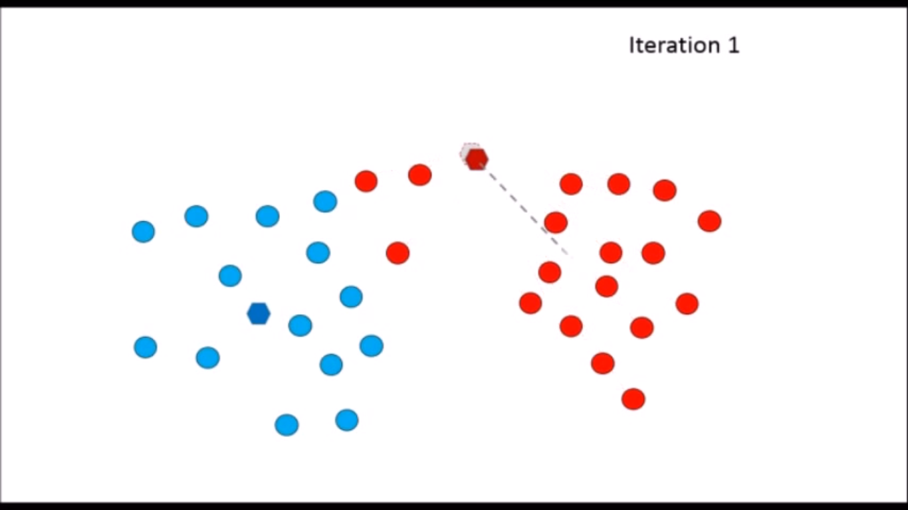
Methodology
Outline
Clustering Technique
Motivation
Introduction
Problem Statement
State of Art
Thesis Contribution
Methodology
Results
Conclusion
List of publication
Future Recommendation
References
Move the centroid to the center of cluster then repetition
Fig10 .
The iteration stops when the Boundary line moves a small tolerance compared to the previous iteration

Slide 25
Methodology
Cluster Combinatorial Auction
Outline
Start
Motivation
Introduction
Problem Statement
State of Art
Thesis Contribution
Methodology
Results
Conclusion
List of publication
Future Recommendation
References
K-means Clustering
Bidding on clusters
Evaluate bids and compute the allocation (TSP) solver
winner
Update Available Clusters
Update Available Agents
Is Clusters=0
No
Stop

Slide 26
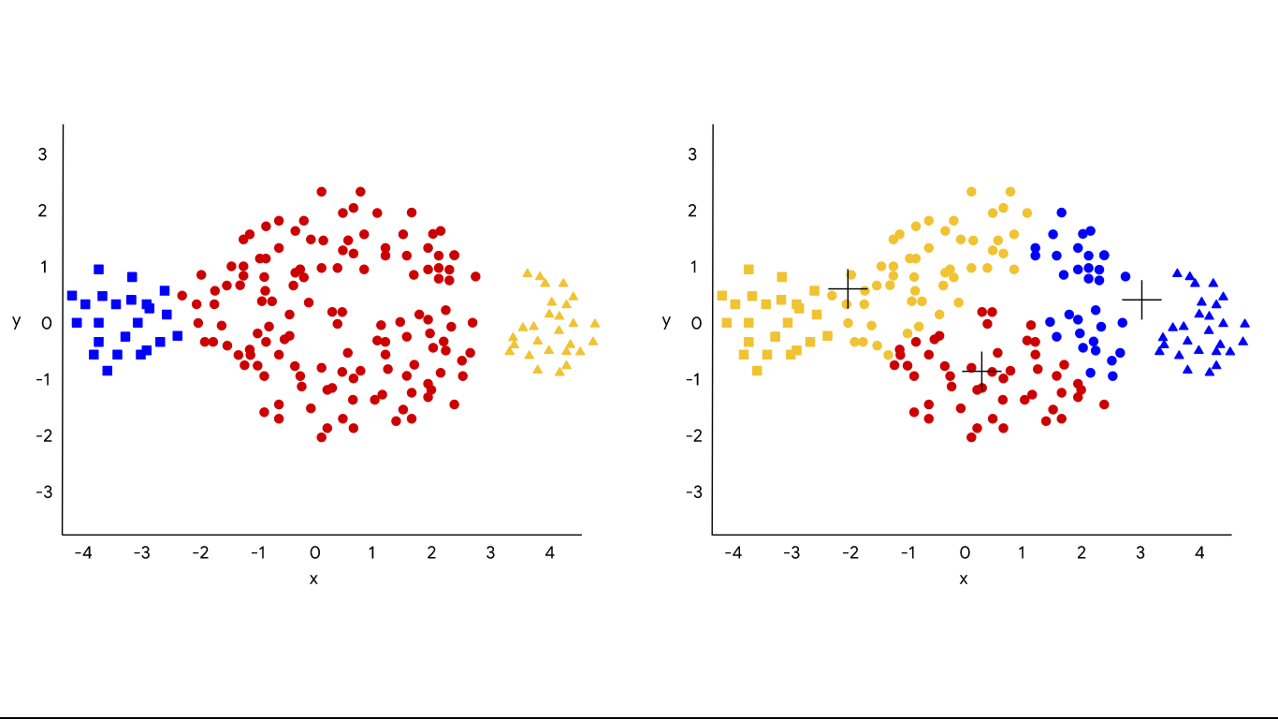
Methodology
Outline
Motivation
Introduction
Problem Statement
State of Art
Thesis Contribution
Methodology
Results
Conclusion
List of publication
Future Recommendation
References
Iterative Market
K-means ’ s main problem is dependency on the initially chosen centroids location
It require to be known from the start the number of Clusters ( K ) Assuming k= number of robots when R<T.
Fig 11.
As a solution we make Iteration over the k-means and check the Cost of the Task allocation if better keep it if not continue.

Slide 27
Methodology
Outline
Motivation
Introduction
Problem Statement
State of Art
Thesis Contribution
Methodology
Results
Conclusion
List of publication
Future Recommendation
References
TSP Solver
In the 19th century, the problem of finding a Hamiltonian cycle on a graph was mathematically formulated by Hamilton [13]. The Hamiltonian cycle is a well-known reduction of the mTSP.
One of the most powerful solutions is 2-Opt heuristic technique [14].
Nearest neighbour tour.
2-opt heuristics (exchange of edges).

Slide 28
Results
Outline
Motivation
Introduction
Problem Statement
State of Art
Thesis Contribution
Methodology
Results
Conclusion
List of publication
Future Recommendation
References
The previously proposed approaches was implemented and simulated on Matlab and simulink version 2018a.
The PC used runs a 64-bit Windows operating system with a 1.6 GHz processor and 8 GB ram.

Slide 29
Results
Outline
Motivation
Introduction
Problem Statement
State of Art
Thesis Contribution
Methodology
Results
Conclusion
List of publication
Future Recommendation
References
Proposed Scenarios
Robots = Tasks
Robots >Tasks
Robots < Tasks
Small scale
Medium scale
large scale

Slide 30
Results
Outline
Motivation
Introduction
Problem Statement
State of Art
Thesis Contribution
Methodology
Results
Conclusion
List of publication
Future Recommendation
References
Performance Metrics
In the different simulated scenarios we measure our algorithm performance according to some criteria.
• Computation time.
• Number of tasks compared to Number of Robots (Agents).
• Total cost which is total traveled distance for the Robots.
• Maximum cost which represent the maximum distance traveled by a Robot in the system

Slide 31
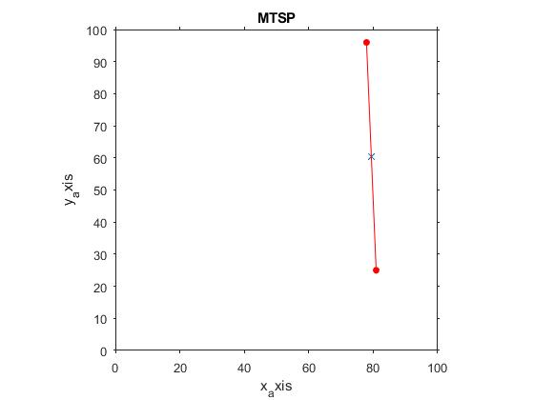
Results
Outline
Motivation
Introduction
Problem Statement
State of Art
Thesis Contribution
Methodology
Results
Conclusion
List of publication
Future Recommendation
References
Cluster Combinatorial Auction
Small scale
Robot location
Colored Dot are Tasks
Fig12 Time:12.510116 sec Tasks:5000 Agents:6

Slide 32
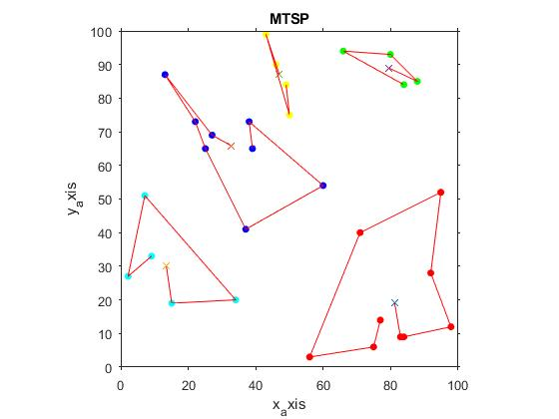
Results
Outline
Motivation
Introduction
Problem Statement
State of Art
Thesis Contribution
Methodology
Results
Conclusion
List of publication
Future Recommendation
References
Cluster Combinatorial Auction
Medium scale
Robot location
Colored Dot are Tasks
Fig 13. Time:12.510116 sec Tasks:5000 Agents:6

Slide 33
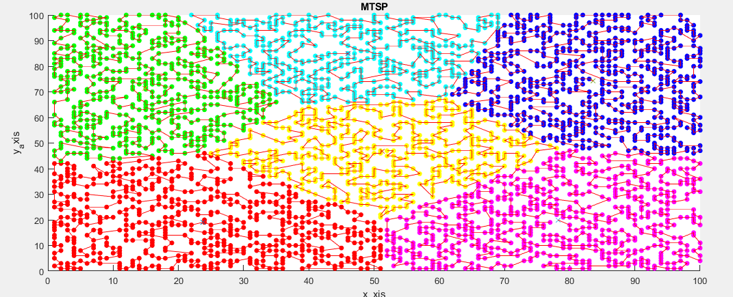
Results
Outline
Motivation
Introduction
Problem Statement
State of Art
Thesis Contribution
Methodology
Results
Conclusion
List of publication
Future Recommendation
References
Cluster Combinatorial Auction
large scale
Robot location
Colored Dot are Tasks
Fig 14. Time:12.510116 sec Tasks:5000 Agents:6

Slide 34
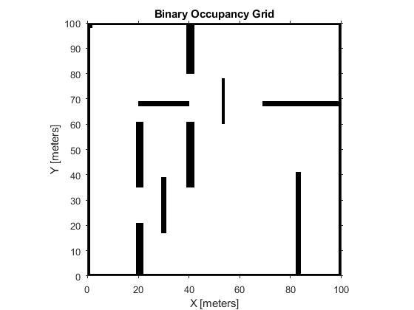
Results
Outline
Motivation
Introduction
Problem Statement
State of Art
Thesis Contribution
Methodology
Results
Conclusion
List of publication
Future Recommendation
References
Implemented Warehouse Map
Warehouse layout was implemented using BinaryOccupancyGrid in MATLAB Robotic toolbox.
A path planning technique was implemented using Graph shortest path and check occupancy methods in MATLAB.
Robots were modeled as small circle with a starting known poses
Fig 15 .

Slide 35
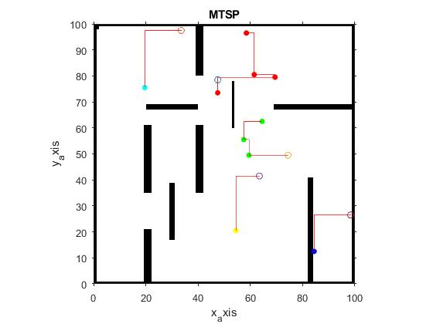
Results
Outline
Motivation
Introduction
Problem Statement
State of Art
Thesis Contribution
Methodology
Results
Conclusion
List of publication
Future Recommendation
References
Cluster Combinatorial Auction
Robots < Tasks
Robots location
Colored Dots are Tasks
Fig 16
Time:0.3326 sec Tasks:10 Agents:5 Max cost:61 Total cost:230.936

Slide 36
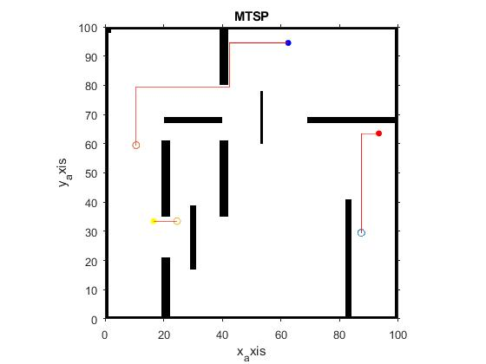
Results
Outline
Motivation
Introduction
Problem Statement
State of Art
Thesis Contribution
Methodology
Results
Conclusion
List of publication
Future Recommendation
References
Cluster Combinatorial Auction
Robots = Tasks
Robots location
Colored Dots are Tasks
Fig 17
Time:0.2752 sec Tasks:3 Agents:3 Max cost:123.03 Total cost:190.9188

Slide 37
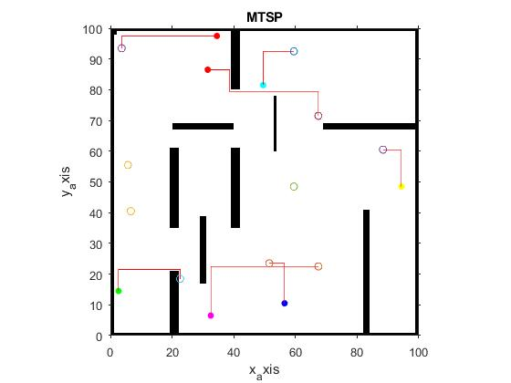
Results
Outline
Motivation
Introduction
Problem Statement
State of Art
Thesis Contribution
Methodology
Results
Conclusion
List of publication
Future Recommendation
References
Cluster Combinatorial Auction
Robots > Tasks
Robots location
Colored Dots are Tasks
Fig 18
Time:0.22055 sec Tasks:7 Agents:10 Max cost:72.12489 Total cost:316.783

Slide 38
Results
Outline
Motivation
Introduction
Problem Statement
State of Art
Thesis Contribution
Methodology
Results
Conclusion
List of publication
Future Recommendation
References
Simulated Experiments
Pure pursuit controller
Fig 19
Time:0.22055 sec Tasks:5 Agents:10 Max cost:65.12489 Total cost:216.783

Slide 39
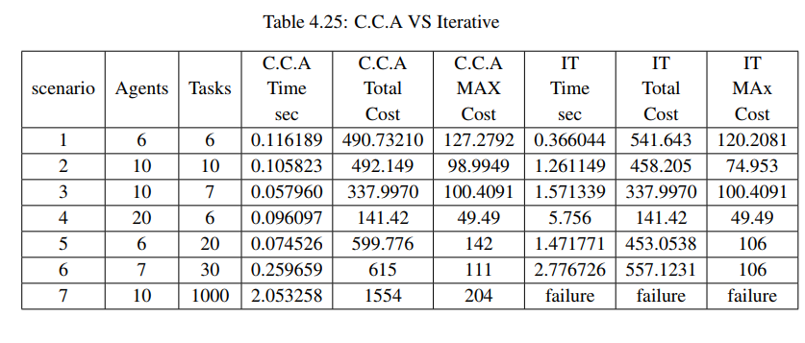
Results
Outline
Motivation
Introduction
Problem Statement
State of Art
Thesis Contribution
Methodology
Results
Conclusion
List of publication
Future Recommendation
References
Comparative Results
Combinatorial Auction VS Iterative Market solution.

Slide 40
Conclusion
Outline
Motivation
Introduction
Problem Statement
State of Art
Thesis Contribution
Methodology
Results
Conclusion
List of publication
Future Recommendation
References
A Cluster Combinatorial Auction
Iterative market Algorithms
K-means was implemented in both Market approaches for Grouping .
A 2-opt heuristic was used in both Market approaches for solving the tour order to fit the objective function.
The problem was formulated as instance of MTSPs
Results shows that:
Cluster Combinatorial Auction (C.C.A) outperformed Iterative Market in computation time however Iterative gives a better cost in the expanses of time.
From the results it is recommend to use Cluster Combinatorial Auction (C.C.A) when
(Robots >Tasks).

Slide 41
List of Publication
Outline
Motivation
Introduction
Problem Statement
State of Art
Thesis Contribution
Methodology
Results
Conclusion
List of publication
Future Recommendation
References
Wessam Shoman, Mahmoud El-Barrawy, Youssef Mekhail, Ali B. Bahgat, El Sayed I. Morgan. "Introducing Various Novel Optimization Techniques for Task Allocation in Multi-Vehicles Systems", ICVES 2019 (Under review).

Slide 42
Future Recommendation
Outline
Motivation
Introduction
Problem Statement
State of Art
Thesis Contribution
Methodology
Results
Conclusion
List of publication
Future Recommendation
References
Investigate different algorithms
Include a heterogeneous Robots systems to accommodate more realistic scenarios.
Include the robot dynamics in the model to be more applicable in the real world.

Slide 43
References
Outline
1-Khamis, A., Hussein, A. and Elmogy, A., 2015. Multi-robot task allocation: A review of the state-of-the-art. In Cooperative Robots and Sensor Networks 2015 (pp. 31-51). Springer, Cham.
2-Otte, M., Kuhlman, M.J. and Sofge, D., 2019. Auctions for multi-robot task allocation in communication limited environments. Autonomous Robots, pp.1-38.
3-Sandholm, T., 2002. Algorithm for optimal winner determination in combinatorial auctions. Artificial intelligence,135(1-2), pp.1-54
4-Berhault, M., Huang, H., Keskinocak, P., Koenig, S., Elmaghraby, W., Griffin, P. and Kleywegt, A., 2003, October. Robot exploration with combinatorial auctions. In Proceedings 2003 IEEE/RSJ International Conference on Intelligent Robots and Systems (IROS 2003)(Cat. No. 03CH37453) (Vol. 2, pp. 1957-1962). IEEE..
6-https://www.semanticscholar.org/paper/A-transformation-for-a-Multiple-Depot%2C-Multiple-Oberlin-Rathinam/586faa34127ff21a746189e562a5c0ed33f8e3d8
7-Murugappan Elango, Subramanian Nachiappan, and Manoj Kumar Tiwari. Balancing task allocation in multi-robot systems using k-means clustering and auction based mechanisms. Expert Systems with Applications, 38(6):6486–6491, 2011.
8-Omar Cheikhrouhou, Anis Koubaa, and Hachemi Bennaceur. Move and improve: A dis- ˆ tributed multi-robot coordination approach for multiple depots multiple travelling salesmen problem. In 2014 IEEE international conference on autonomous robot systems and competitions (ICARSC), pages 28–35. IEEE, 2014.
Motivation
Introduction
Problem Statement
State of Art
Thesis Contribution
Methodology
Results
Conclusion
List of publication
Future Recommendation
References

Slide 44
References
Outline
9-Sahar Trigui, Anis Koubaa, Omar Cheikhrouhou, Basit Qureshi, and Habib Youssef. A ˆ clustering market-based approach for multi-robot emergency response applications. In 2016 International conference on autonomous robot systems and competitions (ICARSC), pages 137–143. IEEE, 2016.
10- Reid Simmons, David Apfelbaum, Wolfram Burgard, Dieter Fox, Mark Moors, Sebastian Thrun, and Hakan Younes. Coordination for multi-robot exploration and mapping. In ˚ Aaai/Iaai, pages 852–858, 2000.
11-Alan C Schultz, Lynne E Parker, and Frank Schneider. Multi-robot systems: from swarms to intelligent automata. Springer, 2012.
12-Otte, M., Kuhlman, M.J. & Sofge, D. Auton Robot (2019). https://doi.org/10.1007/s10514-019-09828-5
13-Norman Biggs, E Keith Lloyd, and Robin J Wilson. Graph Theory, 1736-1936. Oxford University Press, 1986.
14-Shen Lin. Computer solutions of the traveling salesman problem. Bell System Technical Journal, 44(10):2245–2269, 1965
15- https://manypossibilities.net/2013/12/spectrum-auctions-for-beginners/
Motivation
Introduction
Problem Statement
State of Art
Thesis Contribution
Methodology
Results
Conclusion
List of publication
Future Recommendation
References

